Slide 1
HEALTHCARE SYSTEM
Haneefuddin Mohammad -46336082
S .Paleti Samyuktha -46335952
Akshaya K S -46335944
Chandragiri Raju -46336039
Naveen V -46336093

Slide 2
CONTENTS
Introduction
Problem Statement
Software Requirements
Functional Requirements
Non-Functional Requirements
Scope
Entities
Class Diagram
ER Diagram
Use Case Diagram
Sequence Diagram
Future Implementation
Conclusion

Slide 3
Introduction
Our Healthcare System Application aims to streamline the diagnostic process, providing a seamless experience for both administrators and customers. This comprehensive system integrates various diagnostic centers, each offering a range of tests, empowering customers to schedule appointments with ease.

Slide 4
Problem statement
The Healthcare System is a comprehensive solution designed to revolutionize the way healthcare appointments are scheduled and managed. This user-friendly application caters to both administrators and customers, offering a seamless experience through its intuitive features and robust functionalities.
The application encompasses a streamlined process for customers to schedule appointments, administrators to manage diagnostic centers and tests efficiently, and a structured workflow for appointment approval. By focusing on single-test appointments within chosen diagnostic centers, the system ensures precision and reliability in healthcare scheduling.
Appointment data remains in the database until manually deleted by database administrators, ensuring data integrity and aligning with industry standards for life cycle management.

Slide 5
Software Requirements
Operating System : Windows
Language : Java
Software’s : Eclipse IDE
Spring Initializer
Postman
Postgres SQL
Tomcat Server
Junit Mockito

Slide 6
Functional Requirements
User:
Customer can register themselves and log in with their credentials.
Customer should be able to browse diagnostic centers, select a specific test, and schedule an appointment by choosing a date and time.
Customers must be restricted to selecting only one test per appointment to ensure a focused and precise scheduling process
Admin:
Admins should manage diagnostic centers tests and appointment approvals.
Admins must be able to add, remove and update information about diagnostic centers.
Admins should have the capability to add, remove and update details of tests associated with each diagnostic center.
Admin approves appointment which are pending.

Slide 7
Scope
User:
User Registration
Login
Make An Appointment
Admin:
Add Center
Remove Center
Add Tests
Remove Tests
Approval of Appointment

Slide 8
Entities
User
Diagnostic Center
Test
Appointment

Slide 9
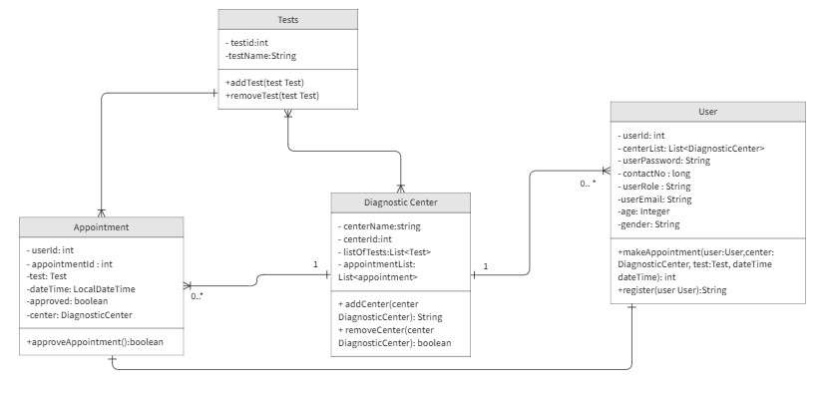
Class Diagram

Slide 10
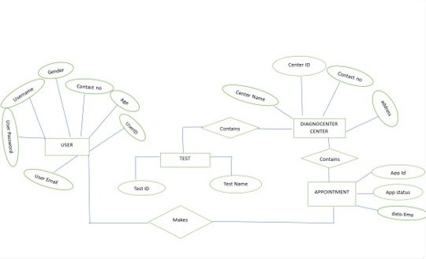
ER Diagrams

Slide 11
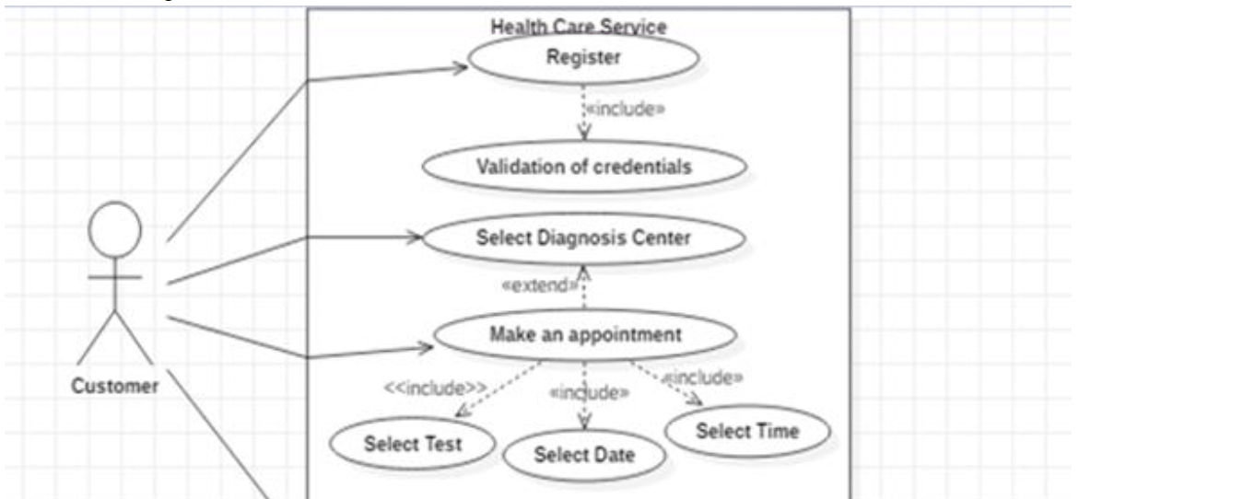
Use Case Diagram

Slide 12
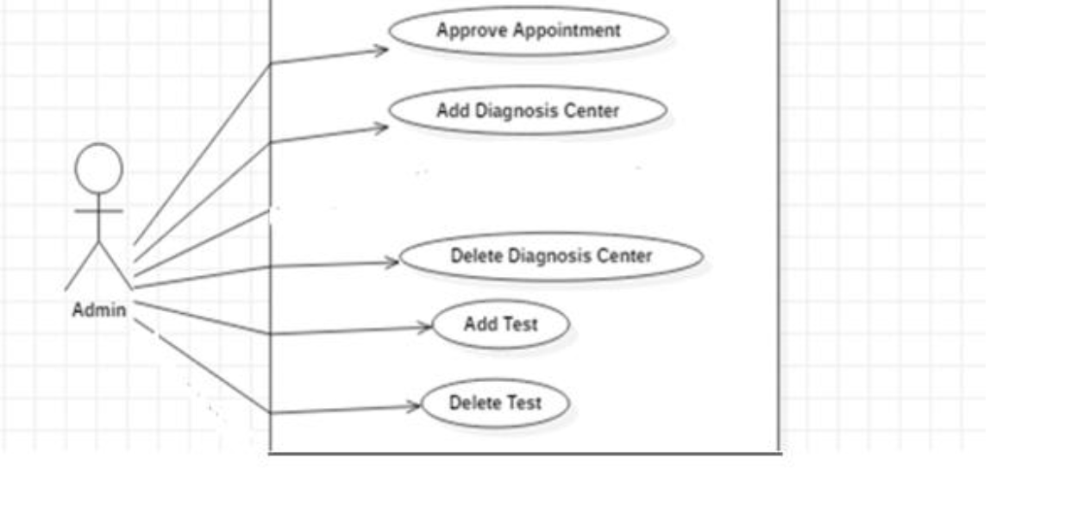
Use Case Diagram

Slide 13
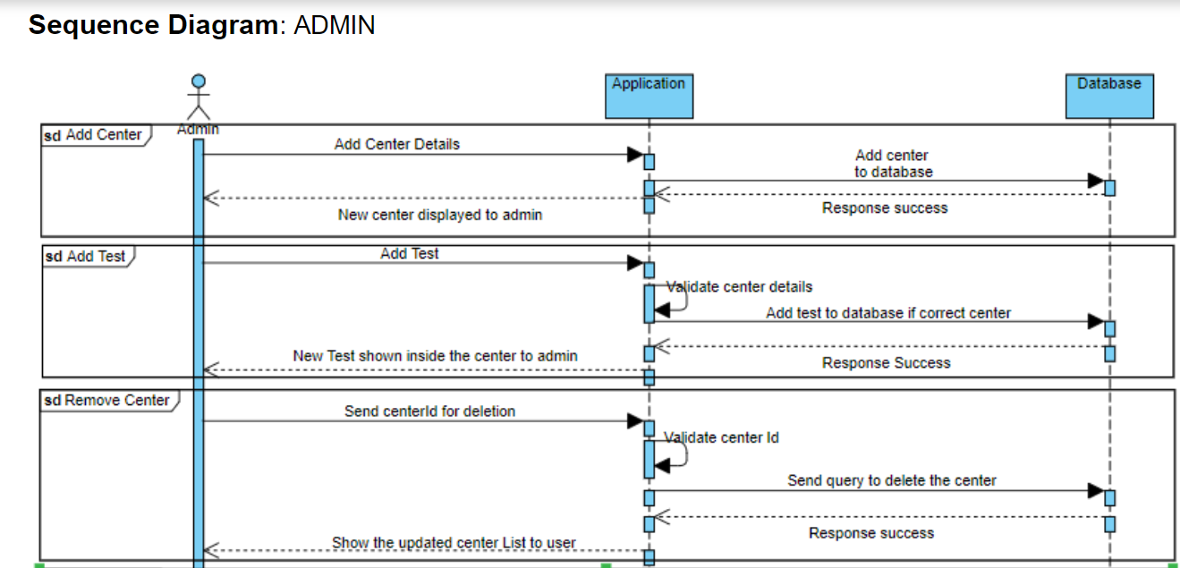

Slide 14
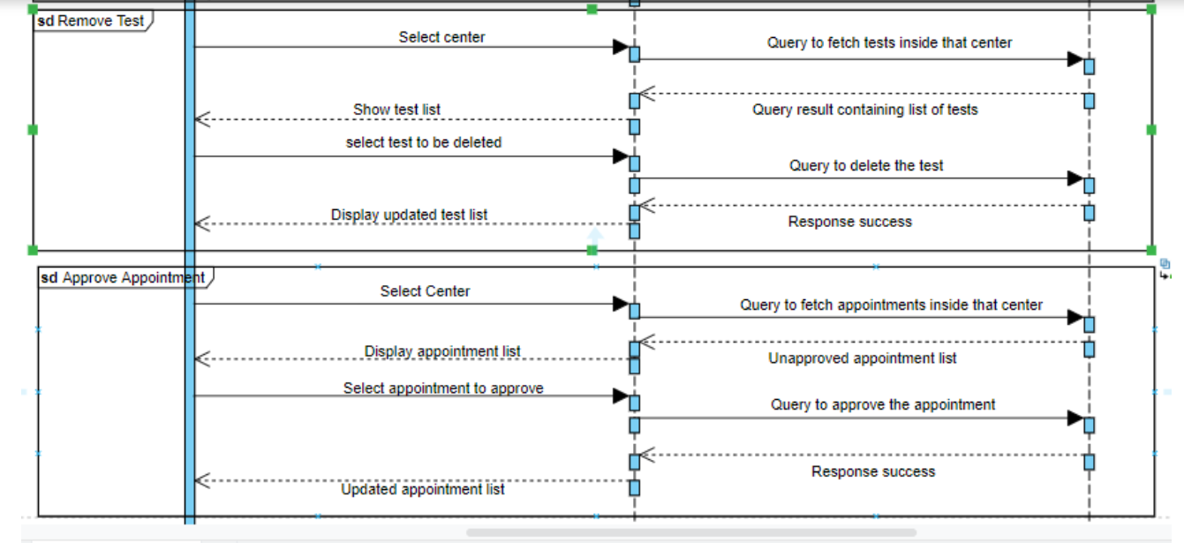
Admin Sequence Diagram

Slide 15
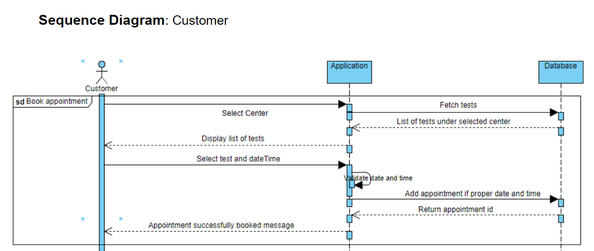

Slide 16
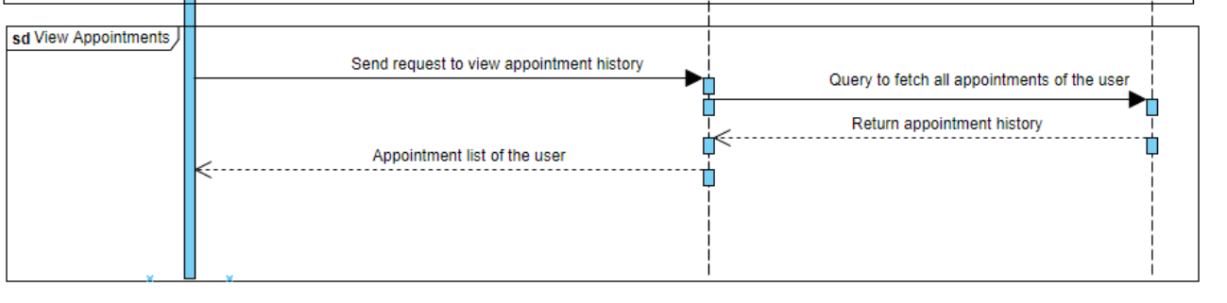
Sequence Diagram: Customer

Slide 17
Future Implementation
Customer Feedback and Ratings:
Add your feedback system for customers to rate and review diagnostic centers and healthcare services, fostering transparency and improving the quality of care.
Appointment Queue management:
Introducing features for managing appointment queues efficiently, reducing wait times and optimizing the workflow of diagnostic centers.
Automatic Appointment Reminders:
Implementing automated reminders for upcoming appointments through email SMS or app notifications reducing no-shows and improving appointment adherence.
Full-fledged application development:
Developing a full-fledged application for increased accessibility allowing user to schedule appointments receive notifications and access health information on the go.

Slide 18
Conclusion
Our healthcare system application offers a user- friendly solution for efficient diagnostic scheduling. It aims to enhance the accuracy and ease of healthcare appointments.
As we look to the future, potential implementations such as patient feedback and rating, appointment queue management promise to further elevate the applications impact, ensuring it remain at the forefront of healthcare technology.

Slide 19
Thank You !!

